Slide 1
Javascript
it’s reasonable
Notes:
I’m Mike, Welcome & Thank you
Why are you here?
Why you should care about Javascript?
Would you be here is ObjectiveC or Prolog?
You do, else not here, a bandwagon? Is it justified?
Certainly the title of this talk is not a ringing endorsement
Target all technical abilities and none
This talk is for anyone involved in or interested in creating computer applications
2 mins (2)

Slide 2

Notes:
Nassim Nicholas Taleb (2007)
history dominated by highly unlikely events
Introduce one of the more unlikely Black Swans of the IT industry
1 min (3)

Slide 3
LiveScript ‘95
Notes:
Written by Brendan Eich
in 10 days to compliment Java
a ‘glue’ language for non-professionals –- reputation to today
heavy-lifting done by Java
‘JavaScript’ to cash in on the cachet of Java
2 mins (5)

Slide 4
F*** You! Money
Notes:
Nassim Nicholas Taleb
Speaking truth to power
1 min (6)

Slide 5
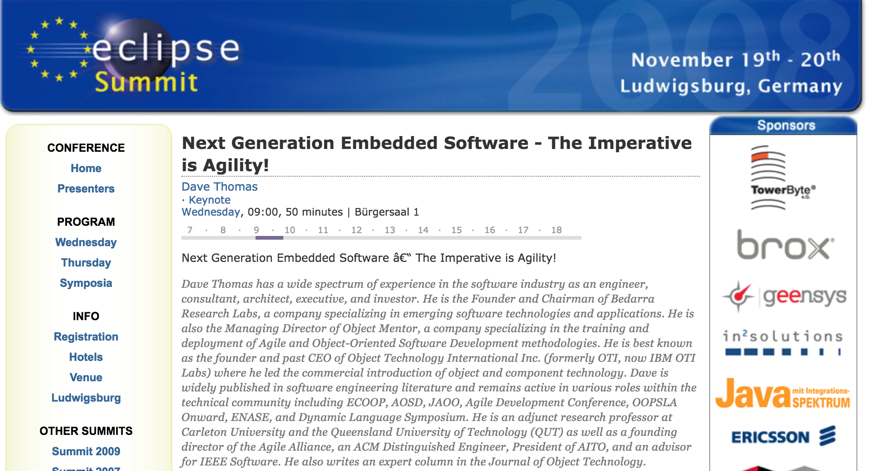
Notes:
EclipseCon 2008
Dave Thomas
dull title – provoke 400 javadevs
2 languages – C & JS
3 mins (9)
I largely agree
This series of talks and workshops is to explain, illustrate, and justify why
NOT: go through language syntax
If you want to learn to write JS, write JS
Instead issues for web programming / programming
At end, everyone better judge if bandwagon is justified…
2 min (11)

Slide 6
Systems Application
Notes:
Dave Thomas proposed a dichotomy
clarify through comparison
black and white in a grey world
divide software development into two
systems = capability
application = business use
1 min (14)

Slide 7
Systems Application
operating systems
database engines
file servers
device drivers
routers
browsers
anything that answers business requirements
Notes:
os
db
file server
device driver
routers
might surprise you – come back to this – browsers -
application
– know what is but struggle for definition
- initially anything involving UX
miss out middleware
so: anything that answers business requirements
1 mins (15)

Slide 8
Systems Application
digital capability
computer science
write for machines
slow, painstaking
optimisation: byte and cycle level
lifetime: decades
costs up front
business value
computer engineering
write for people
fast, replaceable / updatable
optimisation: IO and algorithmic
lifetime: years
ongoing costs
Notes:
look at dichotomy from another perspecive:
engineering vs science
engineering : MVP
bridge analogy
lots of people confused by their role
everyone in this room on right hand side!
5 mins to understand is a lot of nanoseconds
5 mins (20)

Slide 9
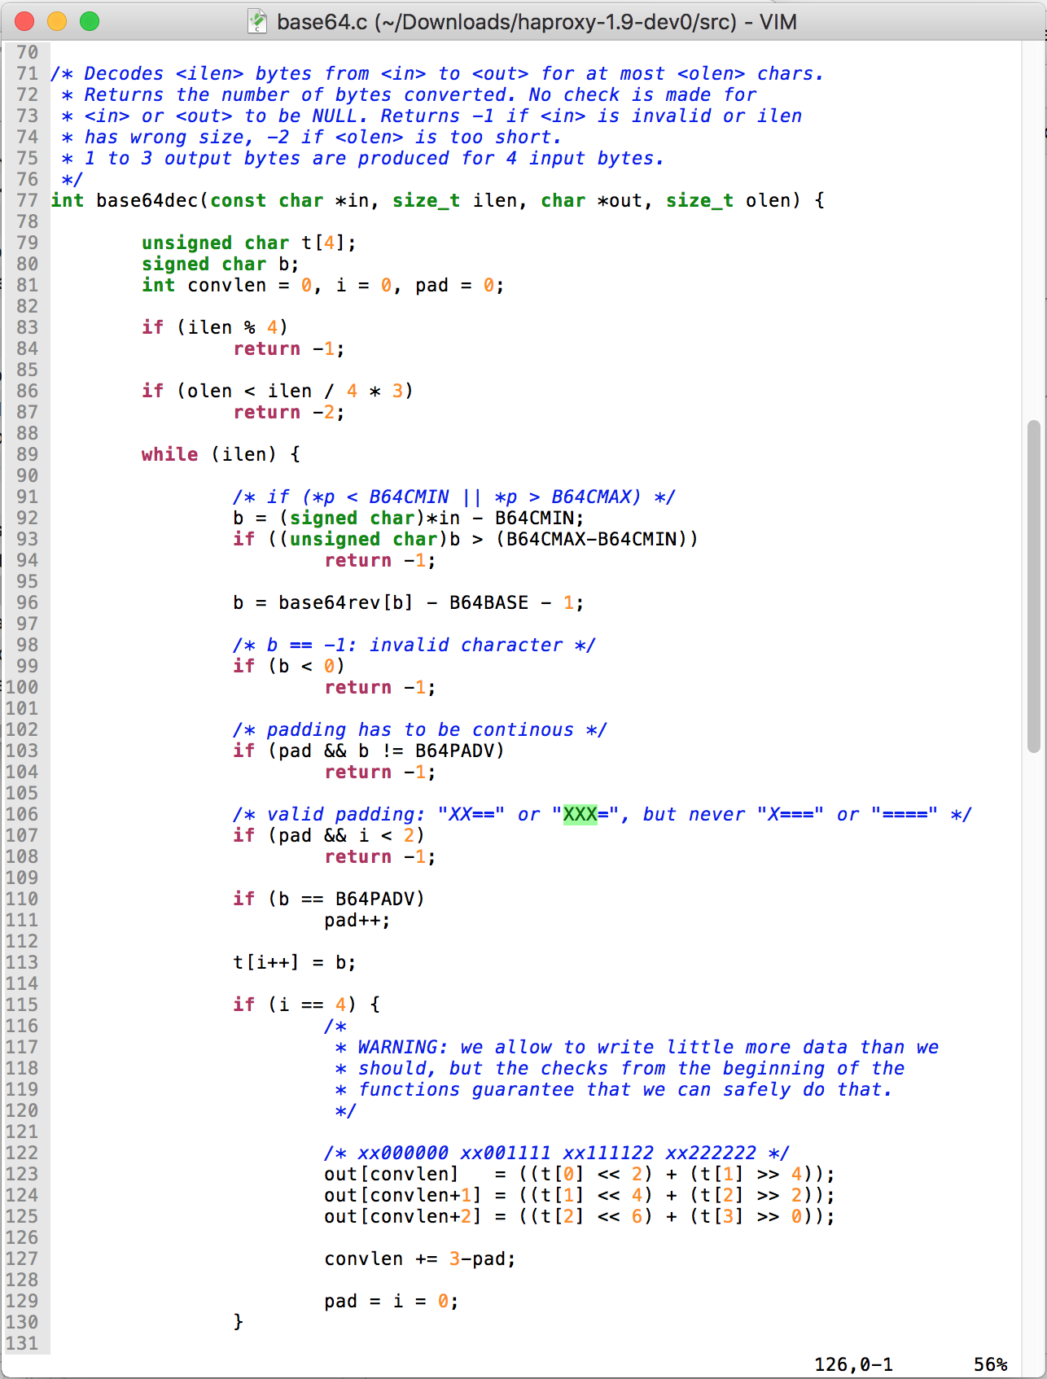
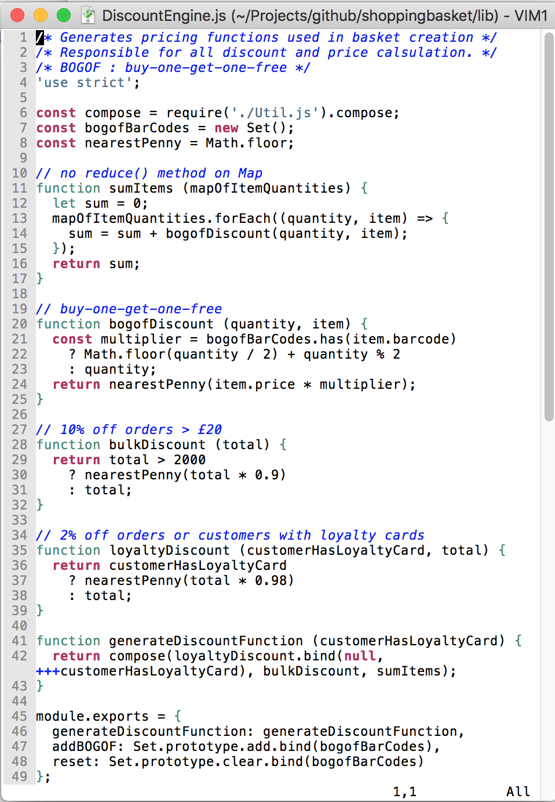
Systems Application
Notes:
haProxy vs example application
memory constructs vs business concepts
fundamental difference
2 mins (22)

Slide 10
Systems Application
C (++)
Java
Python
Ruby
Javascript
etc.
Notes:
so what are the contenders
in systems only 1 – C(++)
some exceptions – Apache Lucene
application – multiple contenders
etc.
so what makes a good application language
switch that – why I think JS is a good app language
2 mins (24)

Slide 11
Javascript Pro’s
easy to learn, not too hard to master
dynamic, i.e. not static
single threaded, run-to-completion
no exposing OS primitives
supports a variety of styles
  imperative / functional
  classical / prototypical inheritance
  callbacks / continuation passing style / es6
Notes:
apologies to non-techies – first case of broad audience
easy: designed, and with caveats (later in course) not too hard to master
no preemptive taxonomies, mix’m match function and structure
single threaded / run-to-completion: you only have to worry about one thing at once
not exposing system-level concepts – let older/younger wiser heads deal with that
forgiving and adaptable – different styles
mixed heritage
OO self/smalltalk
functional: lisp/scheme
what does this all mean?
4 mins (28)

Slide 12
Javascript
it’s reasonable
Notes:
for human beings: powerful enough but reasonable enough to be understood
lots of languages (...Java) confused by their role
Javascript is not
pure unadulterated applications language
2 mins (30)
language syntax and features not all
so other concerns that might disqualify it – will cover three that have been cited
1 min (31)

Slide 13

Speed
(almost) irrelevant
Notes:
much made that it is a script – i.e. interpreted
is not – as we will see later in course subject to dynamic compilation
however it is in pure terms a little slower (not asm) – not pre-digested
all within same ballpark
does it matter?
client / UI code – event loop (next session)
servers – have to be parallel
Cloud context dev/debug costs hugely outweigh runtime costs
2 mins (33)

Slide 14
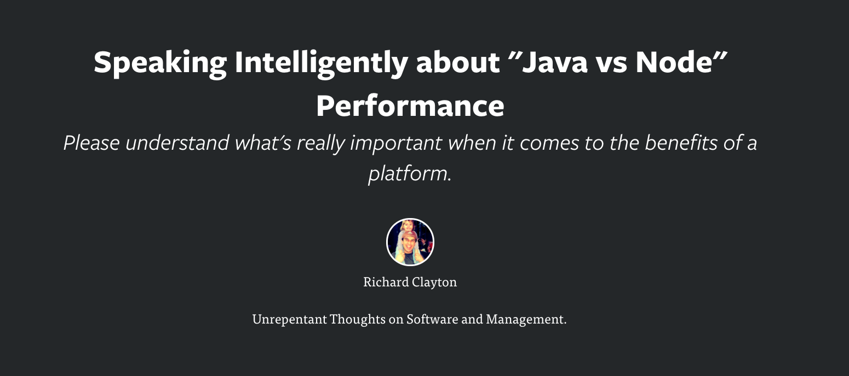
https://rclayton.silvrback.com/speaking-intelligently-about-java-vs-node-performance
Notes:
best summary
1 min (34)

Slide 15

Bugs
Notes:
so if debug costs so important, how buggy?
hard to avoid religious wars
how pull apart language characteristics from developer and testing
different categories of bugs – numerical types, Types
went searching for evidence…
2 mins (36)

Slide 16
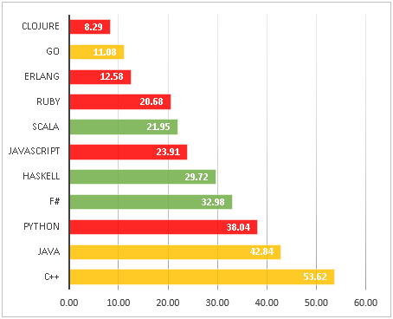
Round 3. Languages sorted by bug density. More than 100 stars repos
https://labs.ig.com/static-typing-promise
Notes:
cherry picking?
most important: functional vs imperative rather than static vs dynamic
1 mins (37)

Slide 17

Popularity
Notes:
‘bandwagon’ but popularity important for 3 things
1. getting help
2. ecosystem
3. useful skill
shockingly JS is popular
1 min (38)

Slide 18
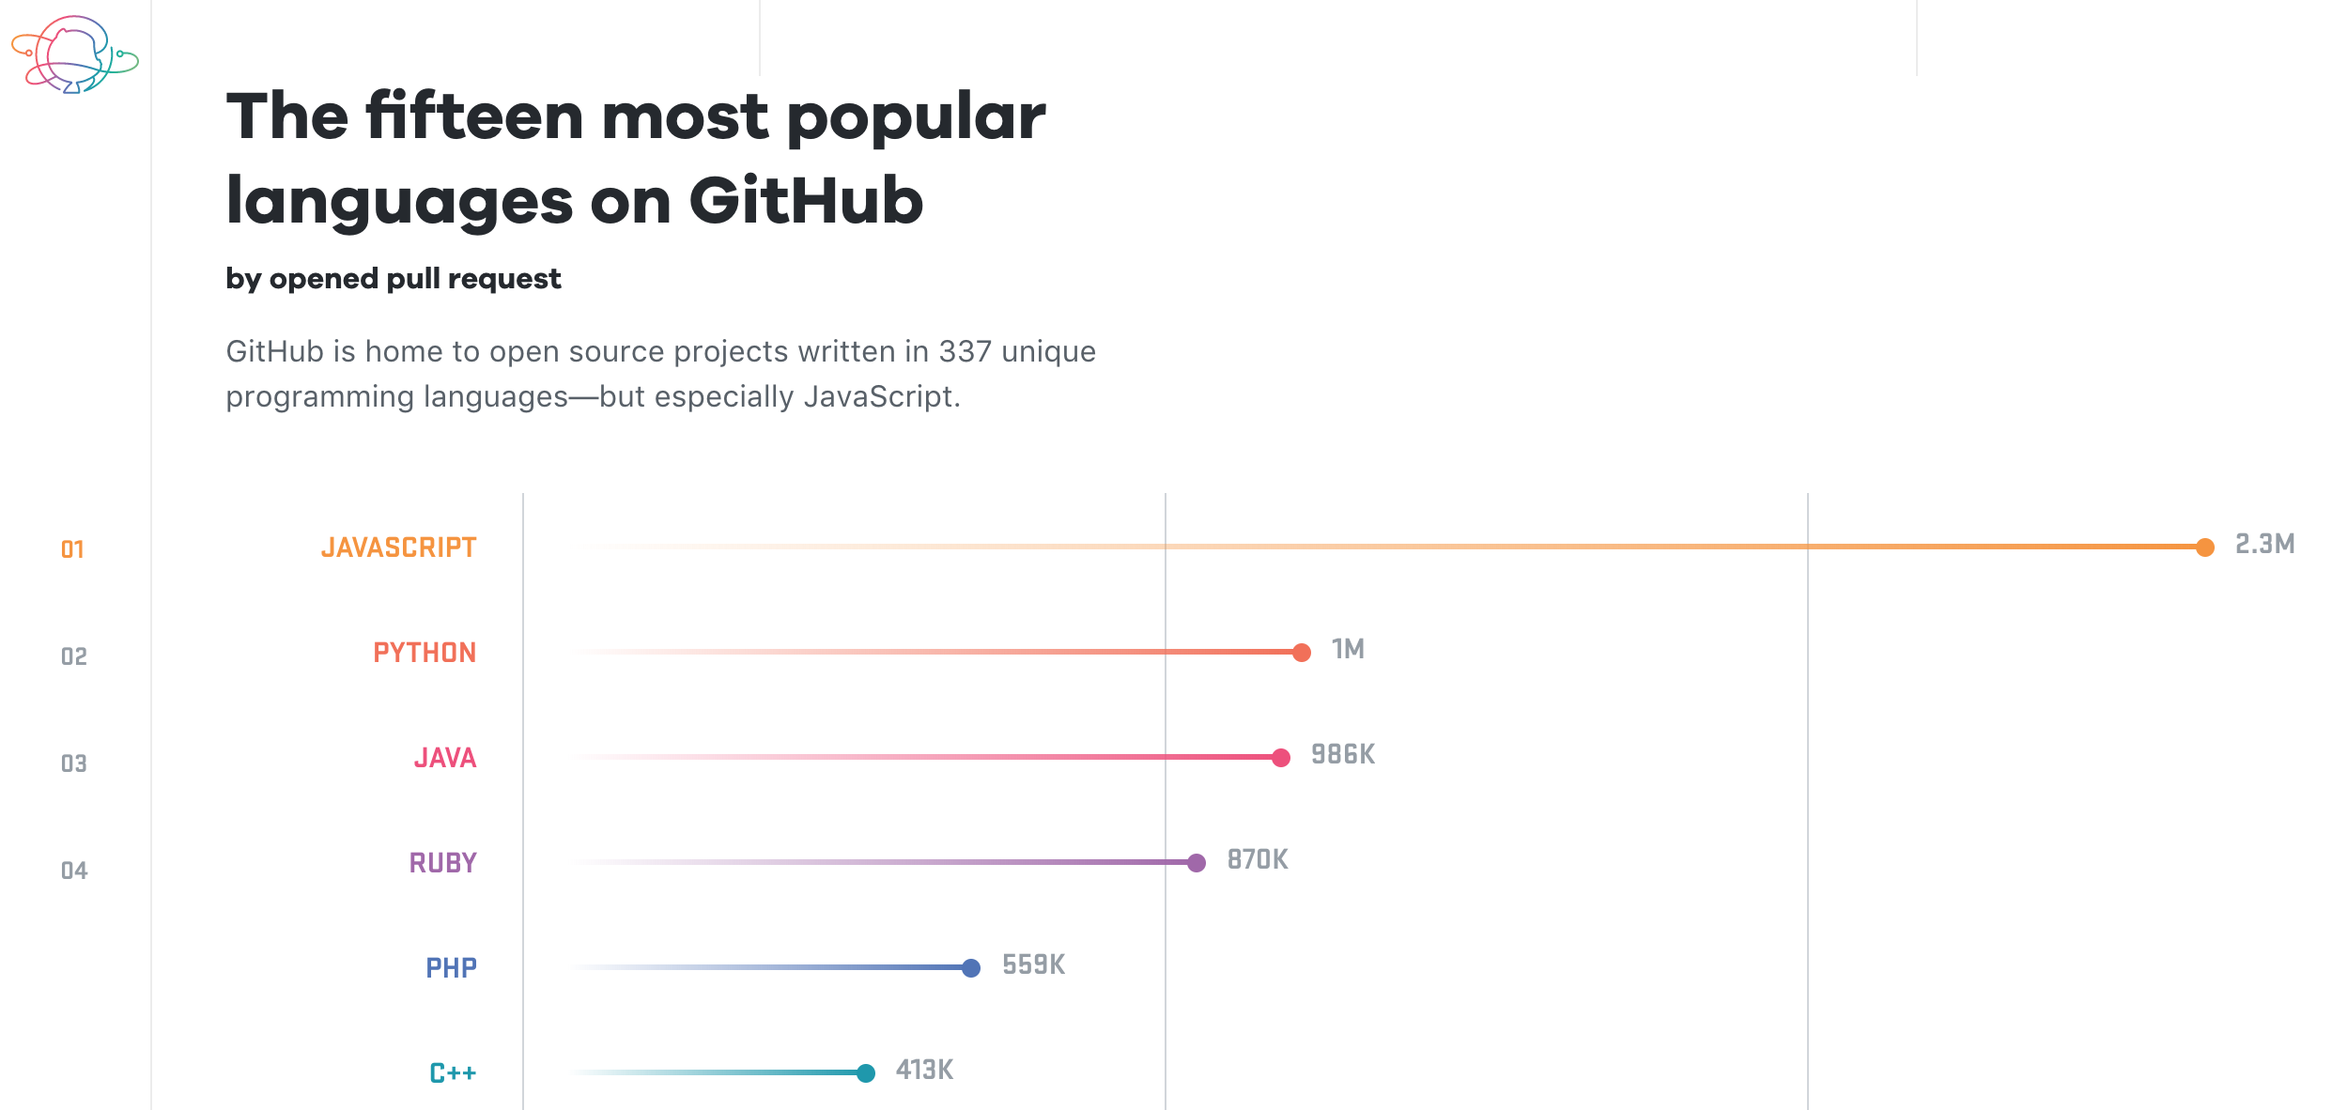
https://octoverse.github.com/
Notes:
github – what it is
octoverse
1 min (39)

Slide 19
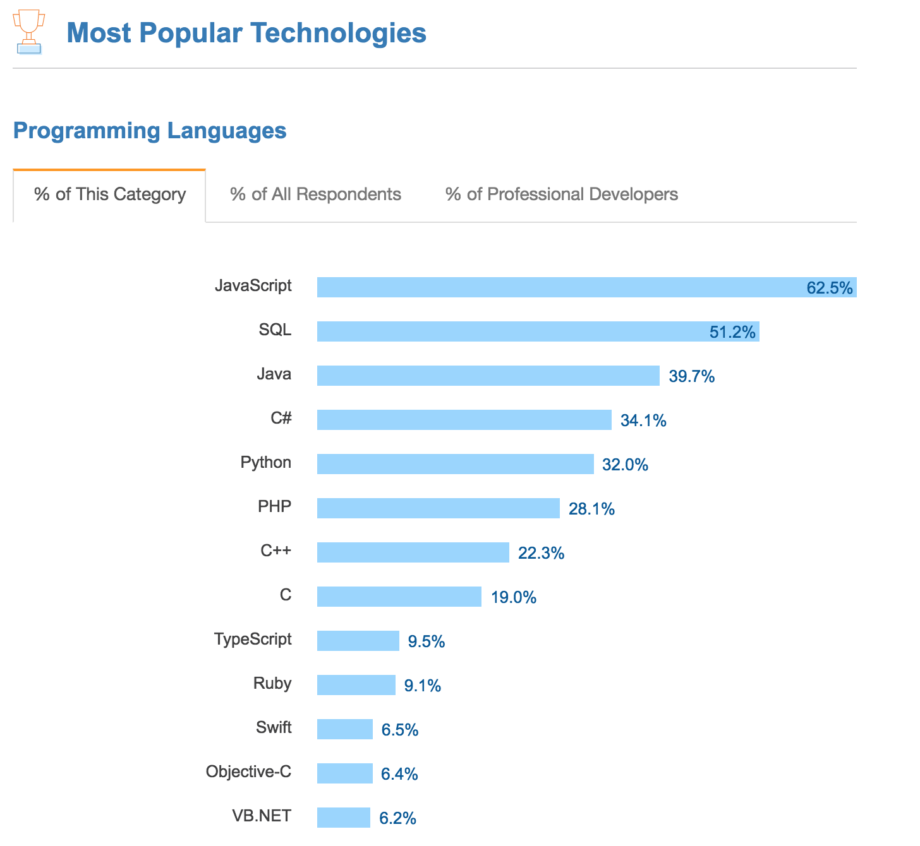
https://insights.stackoverflow.com/survey/2017#most-popular-technologies
Notes:
another (and last) chart
hummed and hawed
1 min (40)

Slide 20
Systems Application
C (++)
JS
Notes:
so there we have it
what dave Thomas was saying
2 languages
JS is reasonable, fast enough, bug-free enough, vastly popular and supported/supportable
of its time
enough?
probably
but one more argument
only language that runs on every browser
is that compelling
next talk...
2 mins (42)

Slide 21


Part 2
Monday 24th February, 12:30
Javascript: its natural habitat - the browser
Notes:
Next session
Same format as today
buzzwords: web 2.0, HTML5
my own: ‘Web Platform’
the power of the browser
issues of our day and how addressed
Why web matters vs 2 elephants in room
2 mins (44)

Slide 22
Part 3 - Tutorial
Monday 2nd March 12:30
’Hello World!’ to XHR
Notes:
normal service resumed – workshops but targetted at non-techies
web 101 – build up web app from basics
in true agile style ‘walking skeleton’
follow along or do yourself
1 min (54)

Slide 23
Pre-workshop preparation
ensure your computer has
  git
  node
  access to:
    https://jsbin.com/
    https://github.com/
OR find a coding buddy who does
OR bring lunch and watch
Notes:
1 min (55)

Slide 24
Part 4
Monday 9th March 12:30
Javascript: its new natural habitat - everywhere
Notes:
greatest innovation in JS world was node
server-side ‘browser’
the role of VM and package manager all rolled into one
of its time – containerisation
one other perspective...
1 mins (56)

Slide 25
Node
Your Javascript code
application
system
V8 compiler
libuv
Notes:
straddles system and application architecture
1 min (46)

Slide 26
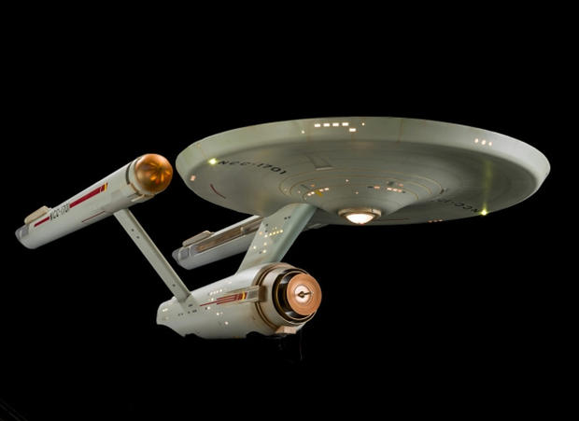
Part 5 : Tutoral
Monday 16th March 12:30
Grown up Javascript – the Enterprise Era
Notes:
more advanced concepts
still simple code
nosde
1 min (56)

Slide 27
Part X
?
Javascript for Java developers
Notes:
contrasting with Java
this talk will focus on how to concentrate in that area
warning non techies – unashamedly techie in bits
however Easter Monday so onllr expecting hard core techies
amongst techies, js has a bad reputation
CHROME CONSOLE: 1+2, 0.1+0.2
2 mins (57)

Slide 28

Notes:
Brendan Eich
when followed his brief, he introduced all the worst bits of Javascript
when he ignored his brief and followed his tech instincts, he over-engineered his solution and produced one of the most adaptable and flexible programming languages we have today
how deal with Janus type language
Douglas Crockford
introduced an approach that I scientifically illustrate here...
2 mins (58)

Slide 29
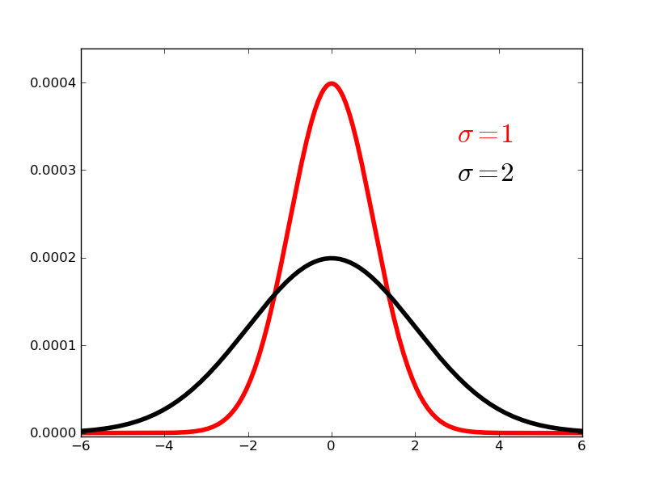
Java
Javascript
bad
ok
good
Notes:
contrasting with Java
this talk will focus on how to concentrate in that area
warning non techies – unashamedly techie in bits
however Easter Monday so onllr expecting hard core techies
1 min (59)

Slide 30
Thank You
michael.morris.evans@lloydsbanking.com

